Slide 1
Application security: implementation

Slide 2
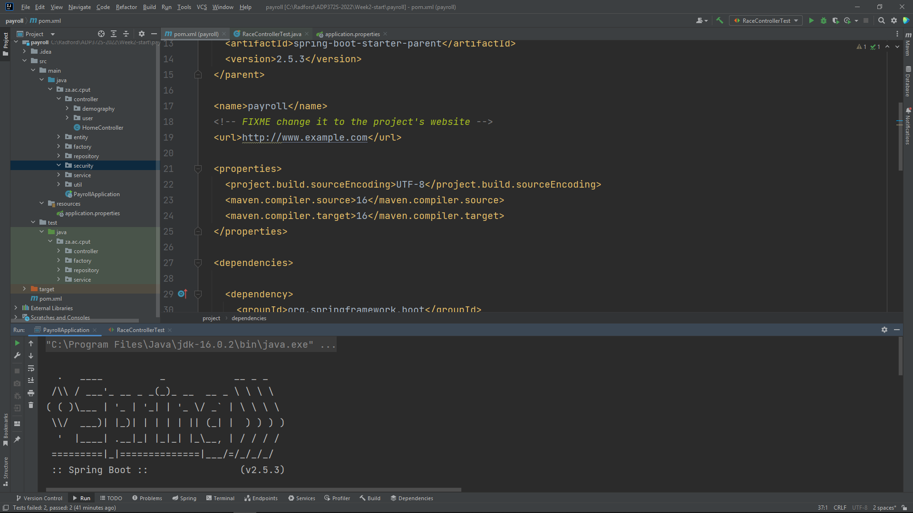
Current stage of our application?

Slide 3
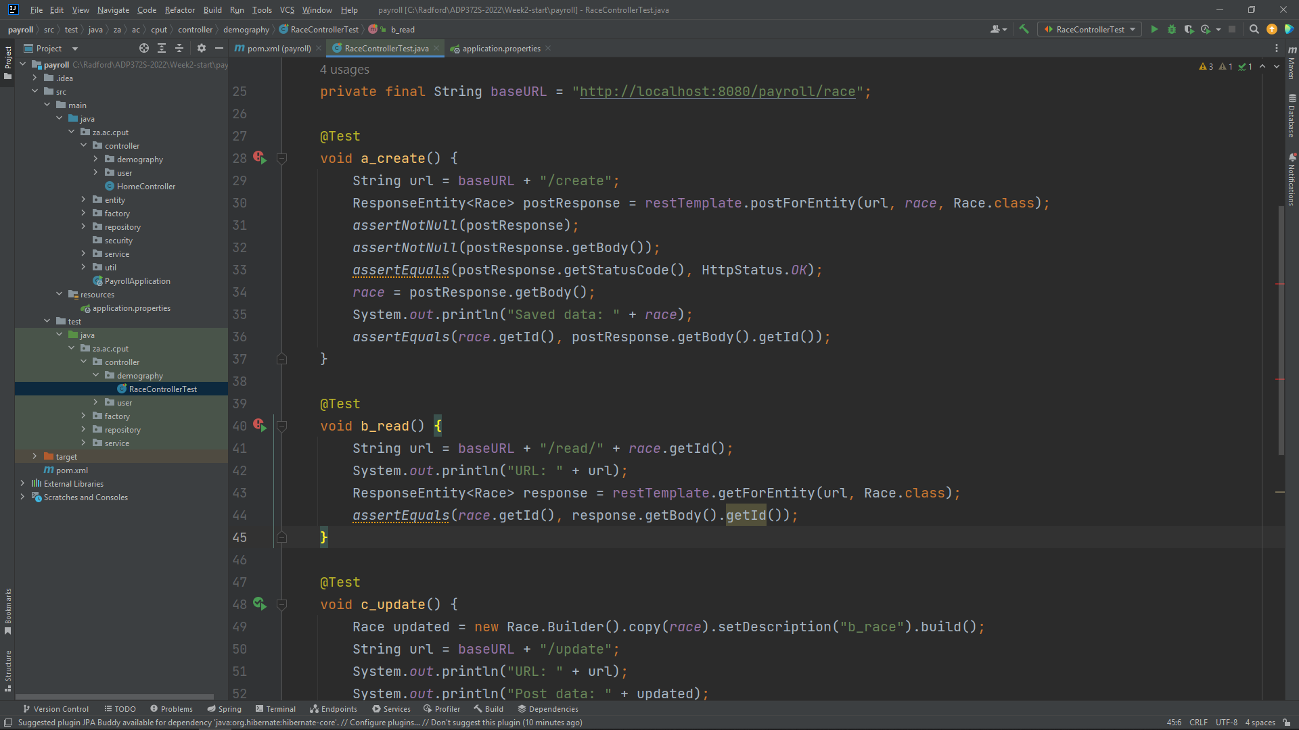
Current stage of our application?

Slide 4
Current stage of our application?
When we run the application, and a controller test, all the tests should pass.
All the endpoints and corresponding functionality defined in the test cases execute without request for authorization.

Slide 5
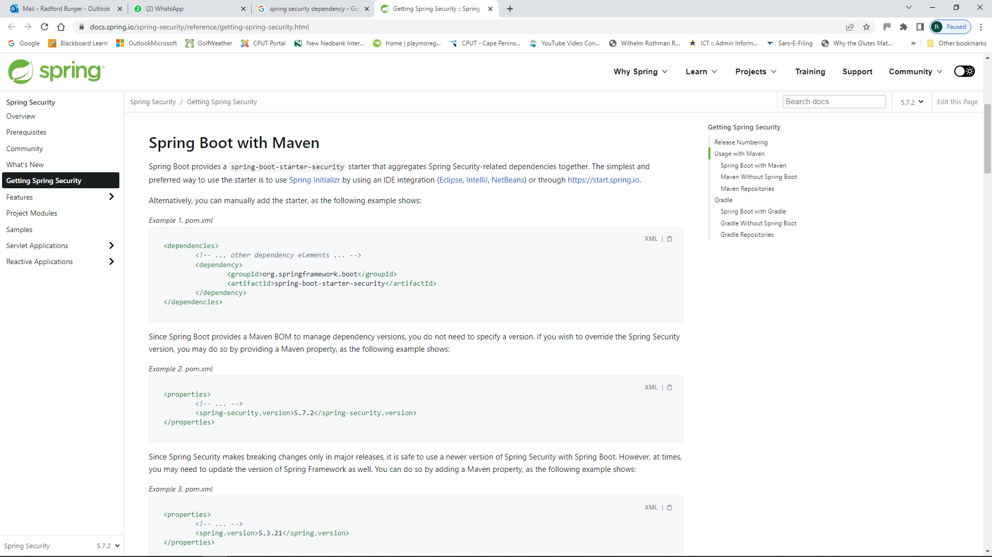
Let’s introduce security functionality:
pom file: add security dependency

Slide 6
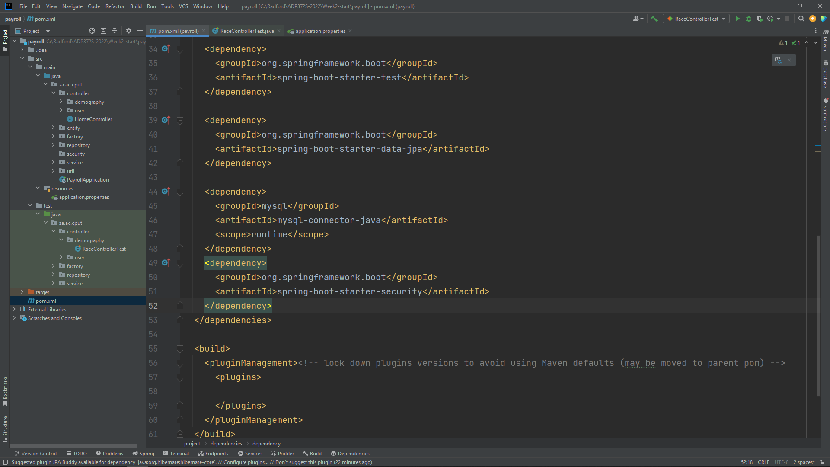
Let’s introduce security functionality:
pom file: add security dependency

Slide 7
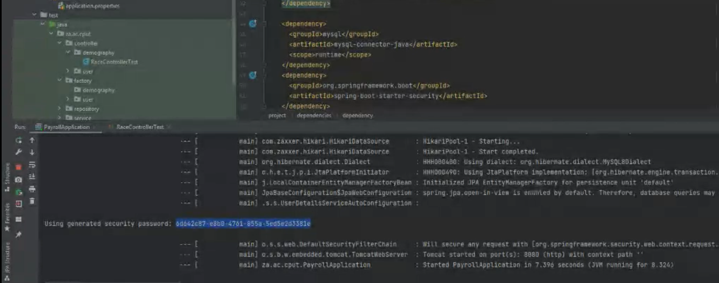
Let’s introduce security functionality:
pom file: add security dependency
Run the application again…

Slide 8
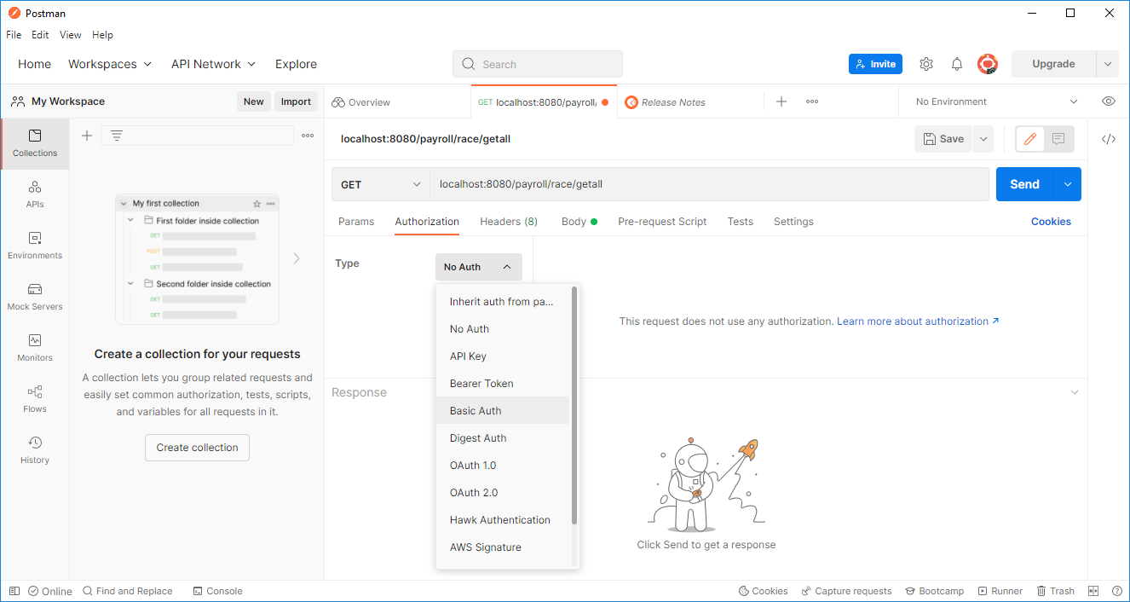
Let’s introduce security functionality:
Use Postman to check authorization

Slide 9
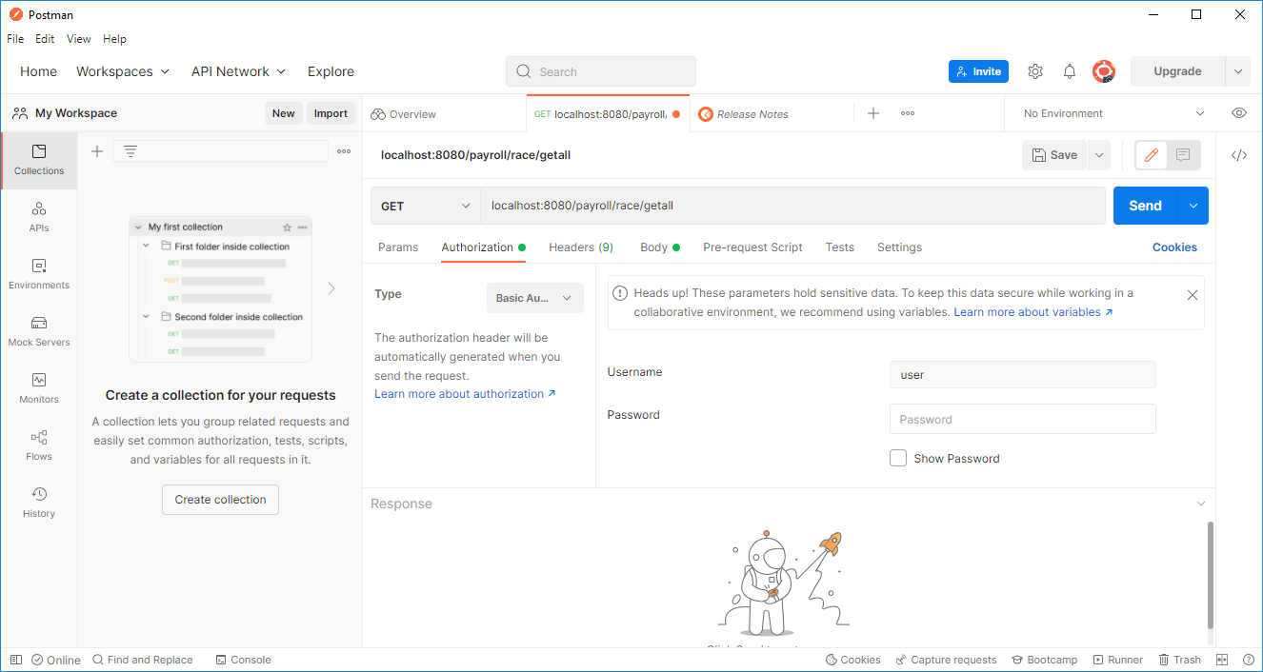
Let’s introduce security functionality:
Use Postman to check authorization

Slide 10
Let’s introduce security functionality:
A different password is generated every time you run the application…

Slide 11
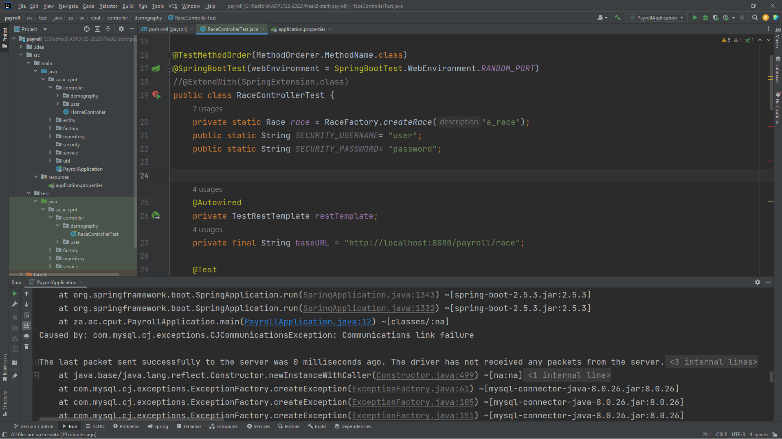
Let’s introduce security functionality:
ControllerTest class

Slide 12
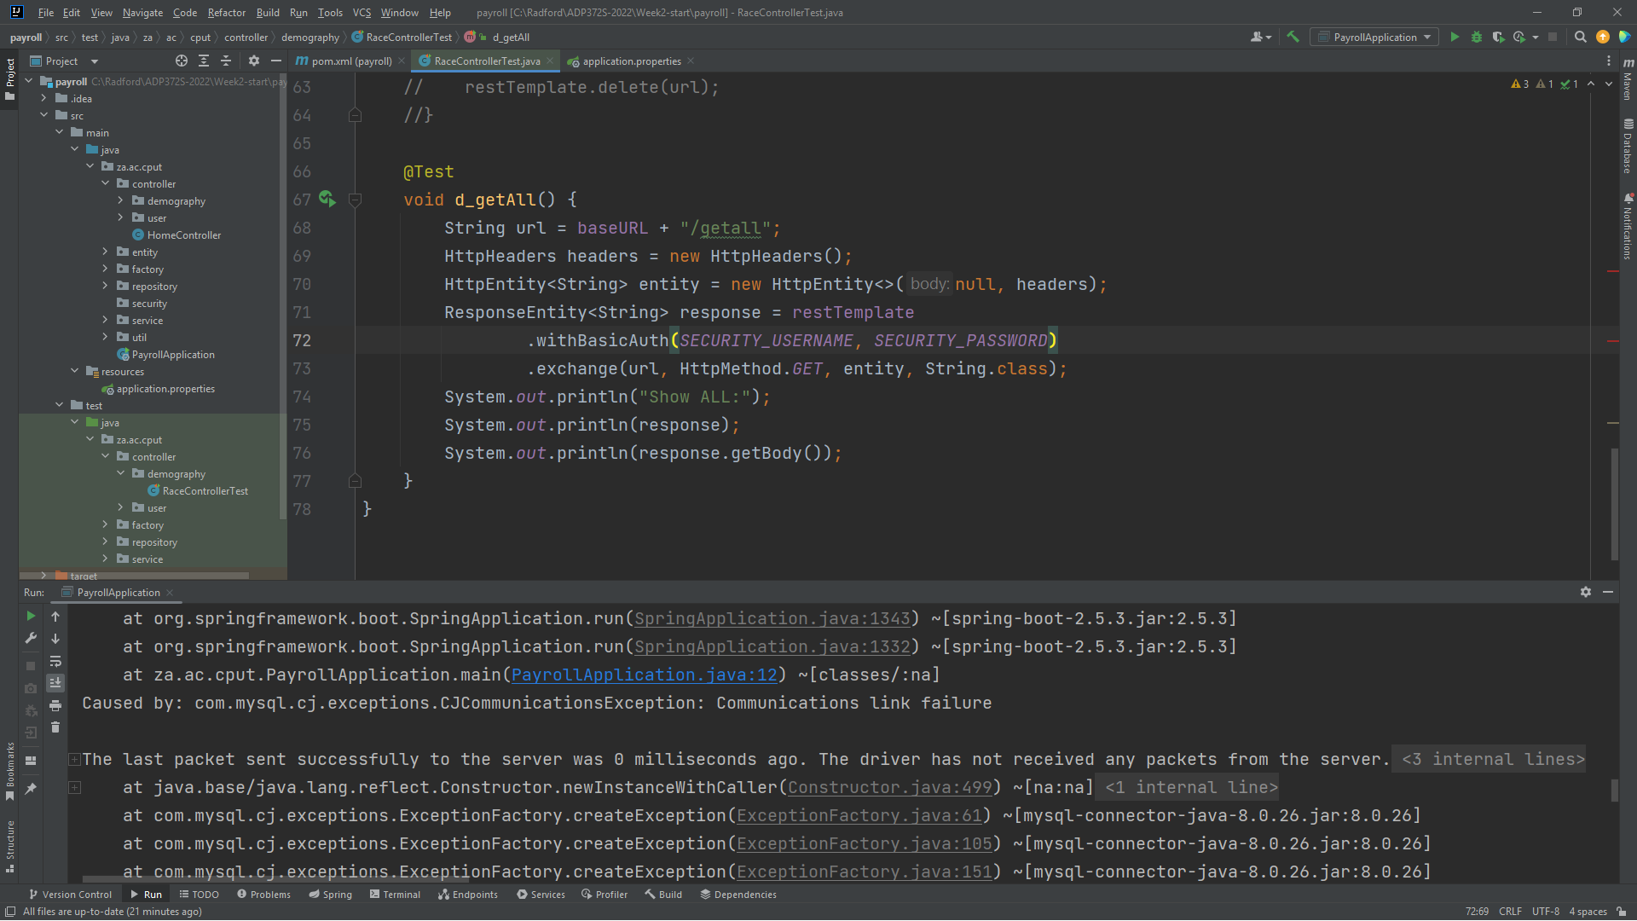
Let’s introduce security functionality:
ControllerTest class: add authorization to a particular endpoint/function

Slide 13
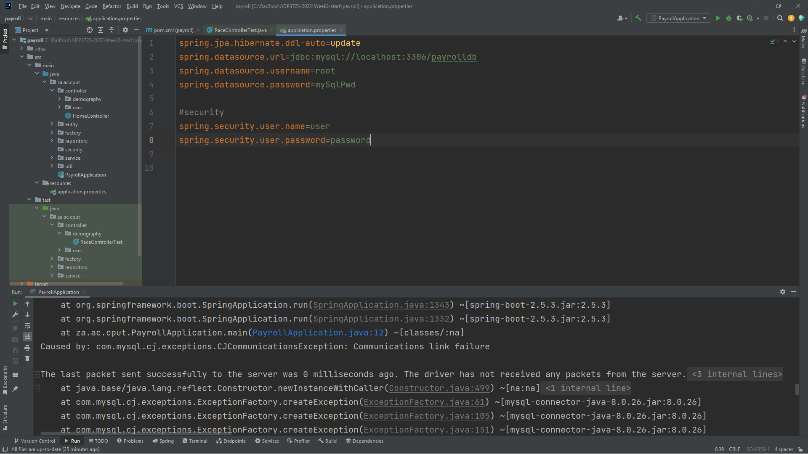
Let’s introduce security functionality:
Configure security in application.properties

Slide 14
Let’s introduce security functionality:
Run application again…
Password is not generated automatically anymore

Slide 15
Let’s introduce security functionality:
Run application again…
Then run controller test case : getall
Should be successful because we have provided the appropriate security credentials.
The other test cases should fail because they do not have authorization functionality added.

Slide 16
Let’s introduce security functionality:
Verify in Postman…with configured user name and password in application.properties

Slide 17
Next week:
Roles and users

